Slide 1



Analyzing Sales Data for
Successful Coffee Shop
Insights from Sales Data Analysis
By Dipanshu Gupta
dipanshugupta780@gmailcom

Slide 2


Introduction
This project aims to give clear insights into sales data by analyzing transaction details, finding patterns, and drawing practical conclusions. By making decisions based on data, businesses can improve operations and boost profitability.

Slide 3


Objectives:
Understand sales distribution over time.
Identify peak sales periods.
Analyze store and product performance.
Provide recommendations based on insights.

Slide 4

Data Overview
Dataset includes the transaction date, timestamp and location, along with product-level details.
Transaction_id, Transaction_date, Transaction_time
Product_category, Product_type, Product_detail
Store_id, Store_location
Transaction_qty, Unit_price, Total_bill

Slide 5
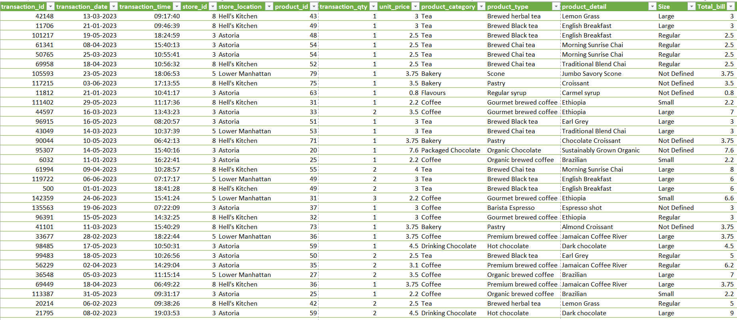
Data

Slide 6

Monthly Sales Distribution
The analysis of monthly sales distribution revealed the following insights:
Sales increased steadily from January to June.
June had the highest number of transactions and total revenue.
February had the lowest number of transactions and revenue.

Slide 7

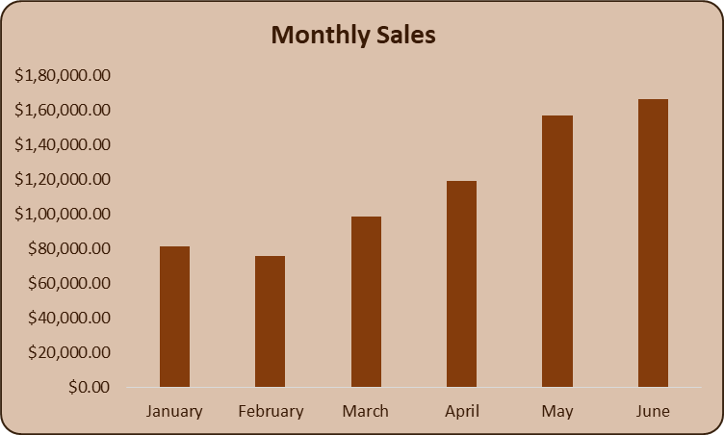
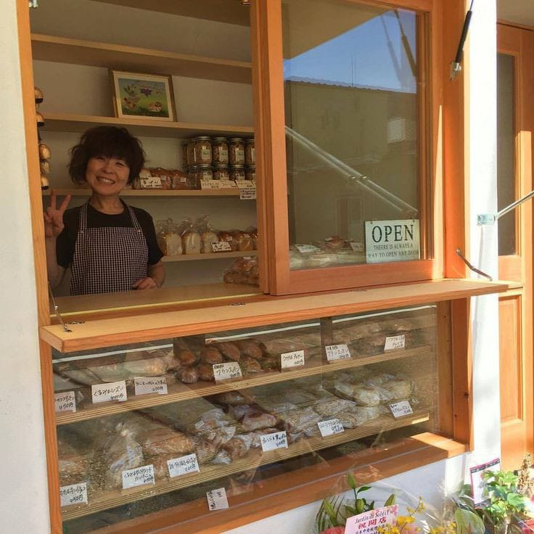

Slide 8

Sales Patterns by Day and Hour
The sales patterns analysis by day of the week and hour of the day showed:
Sales are consistent throughout the week, with Friday having the highest number of transactions and Monday generating the highest revenue.
Sales peak around 8 AM to 10 AM, with the lowest sales occurring at 8 PM.

Slide 9

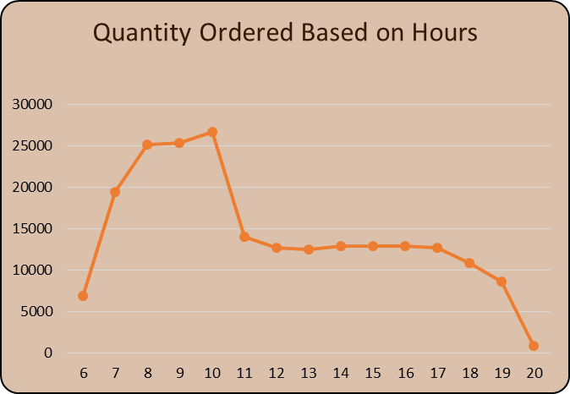
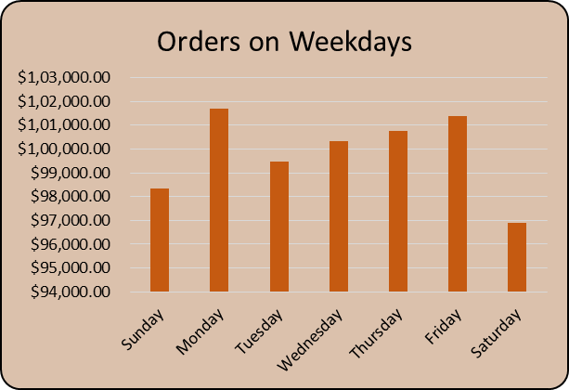


Slide 10

Store Performance
The performance of different store locations was analyzed:
Stores varied in the number of transactions and total revenue.
Comparative analysis of top-performing and underperforming stores provides insights for operational improvements.

Slide 11

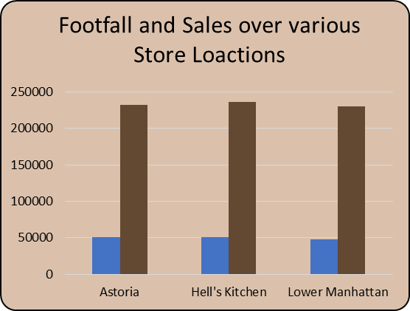




Slide 12


Product Analysis
The product analysis identified top-selling products and analyzed product categories:
Top-selling products were identified.
Analysis of product categories and types helped understand customer preferences.

Slide 13

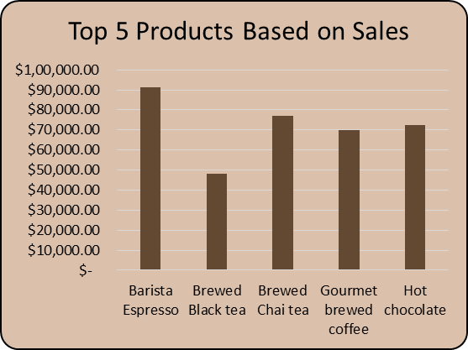
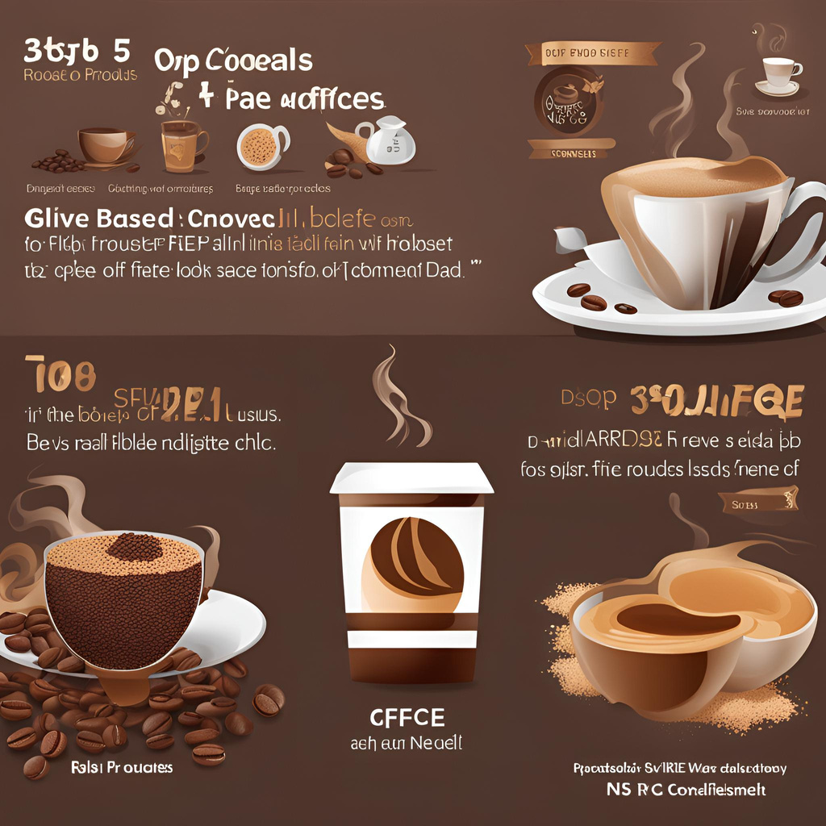

Slide 14

Conclusion
Key findings from the analysis include:
- Sales peak during morning hours and are
consistent throughout the week.
- Store performance varies significantly, with some stores outperforming others.
- Top-selling products and categories were identified, providing insights into customer preferences.

Slide 15

Recommendations
Recommendations based on insights:
- Focus marketing efforts on peak sales hours.
- Investigate factors contributing to lower sales on Saturdays.
- Adjust inventory for top-selling products.
- Explore promotional opportunities during
identified peak times.

Slide 16

End of Presentation
Thank You
Dipanshu Gupta
Coffee Shop
New York City
123-456-7890
www.coffee.com
coffeeshop1204@gamil.com

